Slide 1
Classification of Problems - Algorithm Analysis
Members:
Gonzales Aburto, Ricardo Daniel 18200061
Huamani Avendaño, Dulce 18200219
Molina Yupanqui, Flor 18200164
Palomino Loa, Junior 18200172
Quispe Vega, Anthony Yair 18200179
Vera Leon, Bryan 18200124

Slide 2

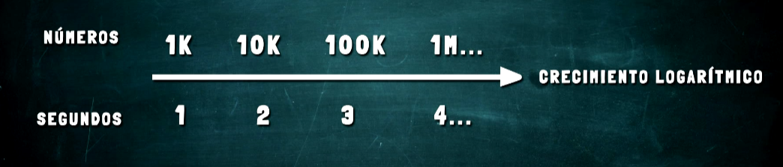
Complexity Theory
It studies how the computational cost grows, mainly in memory and time to solve a certain problem in relation to what the size of that problem grows.
Difference between problem and algorithm?

Slide 3
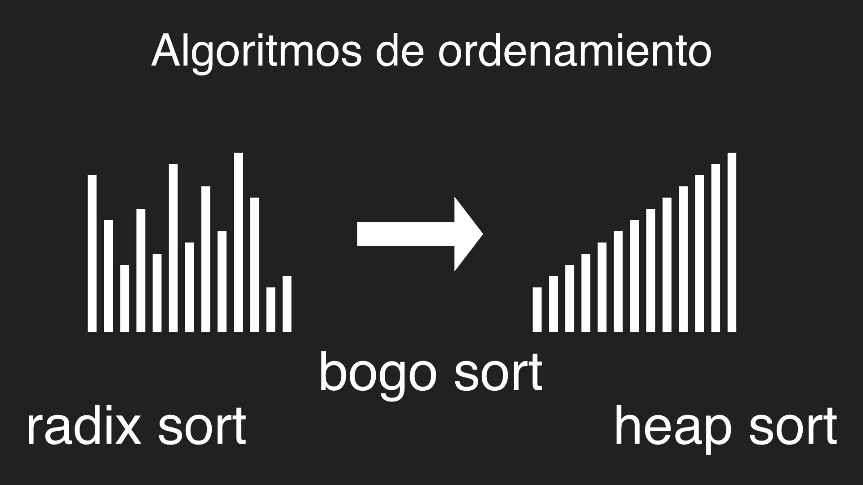
Problem P
Set of problems in which we can find an answer to the problem in a reasonable time.

Slide 4
Problem NP
NP (Non-Deterministic Polynomial) problems are those whose solution may be difficult to find, but at the same time are easy to prove through a polynomial algorithm.
Examples:
Towers of Hanoi
Shell Sort

Slide 5
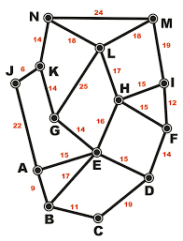
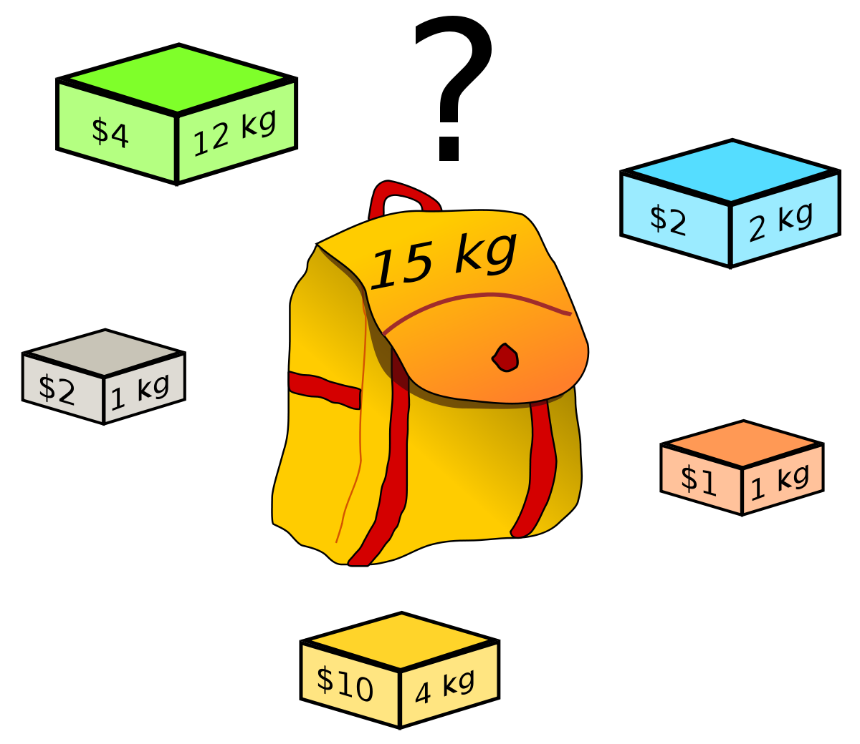
NP Problem - Complete
They are problems belonging to a subset of class np, these problems are considered the most difficult of class NP.
Traveler's problem
Backpack problem

Slide 6


Decision problems
In a decision problem, the instances are divided into two classes: yes and no.
Kinds of decision problems
ZPP
RP
BPP

Slide 7
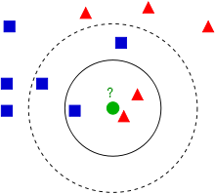
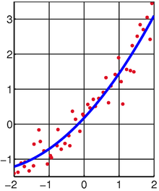
Localization problems
Location problems are those where it is about finding the best location of a facility within a geographical space.
Least squares algorithm
k-NN Nearest Neighbor Algorithm

Slide 8

Optimization issues
It consists of finding a structure that verifies the constraints of a problem and optimizes at least one criterion.
Optimization > Location > Decision

Slide 9

THANK YOU !!!!!!!!!

